Slide 1
IR.1101 - Réseaux/Networks
Final Project
Comparative Analysis of
Distance-Vector & Link-State Routing Protocols
Based on RIP and OSPF
PRESENTATION
Group 2:
FU Jintao GUO Xiaofan LIN Yingqi
LIU Yang YIN Chenghao ZHAO Chao
18 / 01 / 2024

Slide 2
TABLE OF CONTENT
Introduction
Routing Protocol
Distance-Vector Routing Protocol (RIP)
Link-State Routing Protocol (OSPF)
Comparative Analysis
Implementation
Small-Scale Network (Suitable for RIP)
Large Enterprise Network (Suitable for OSPF)
Hybrid Network (Coexistence of RIP and OSPF)
Conclusion

Slide 3
1.Introduction
Dynamic routing protocols are essential in modern networking, allowing routers to exchange information dynamically, enabling networks to adapt seamlessly to changes.
Protocol Categories
Distance-Vector and Link-State protocols are distinguished by their wide adoption and unique operational mechanisms.
Focus on RIP and OSPF
This presentation will concentrate on two protocols: the Routing Information Protocol (RIP) and Open Shortest Path First (OSPF).
Monitoring and Distribution
Monitoring network changes and distributing this information across routers, making the choice of a suitable routing protocol a key decision in network design and management.

Slide 4
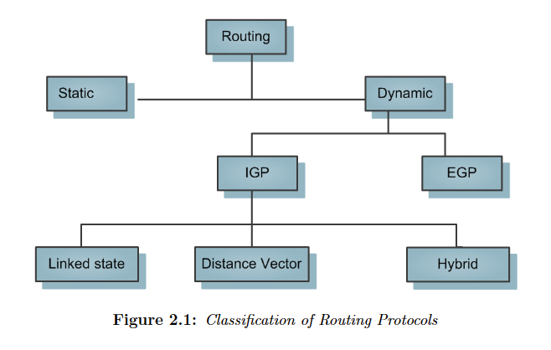
2.Routing Protocol
Operate at 3rd of OSI model(Network Layer)
Purpose: sorting & distribution of IP packets
Attribute and Characteristics:
Best Possible Routers
Faster Convergence
Security Options
Avoiding Loops
Dynamic Route: selected using routing protocol
IGP(Interior Gateway Routing Protocols)
Use for route selection within the autonomous system
Each of routing protocol has their own metric & administrative distances
Figure Source: Khan, Murad; Javaid, Nadeem. (2019, February). “Routing in IP-based Networks.” Thesis. pp.10.[51].

Slide 5
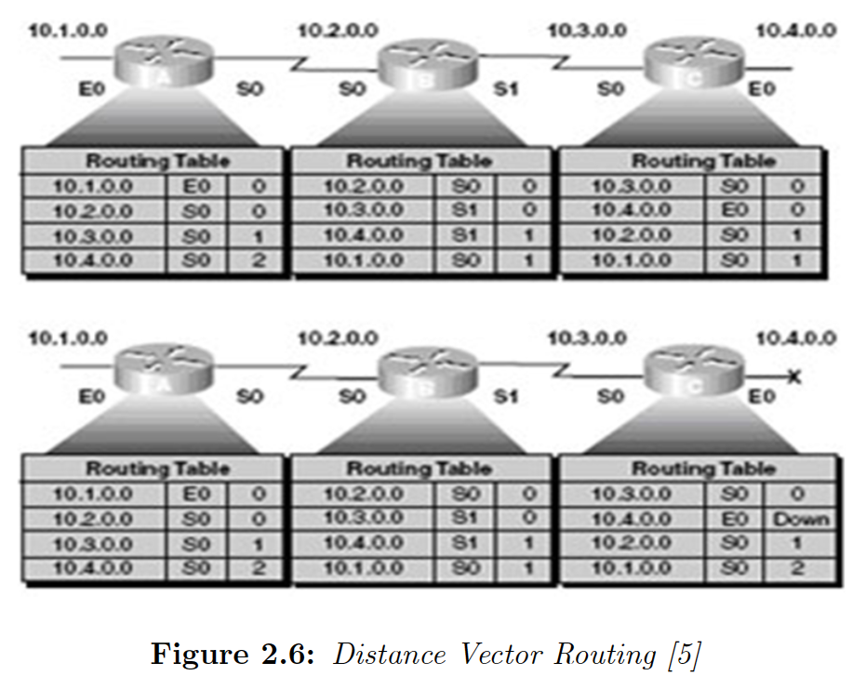
2.1Distance-Vector Routing
The DV Routers
Not know about the complete network topology
Only have info passed by the neighbour devices
The characteristics of DVR protocol
Bellman-Ford Algorithm
Metrics: Distance and Vector (mainly based on Hop-Counts vector)
Defines Routing Table (neighbor routers direct connection)
Periodic Updates
Simple and Efficient
Pros and Cons of DVR
Simple Algorithm
Easy To Implement
Occupies Less Memory & Processor
Figure Source: Khan, Murad; Javaid, Nadeem. (2019, February).
“Routing in IP-based Networks.” Thesis. pp.16.[51].
Loops May Occur
Regularly Updated
Single Parameter

Slide 6
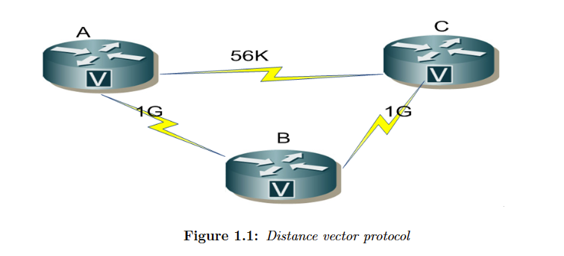
2.1.1Routing Information Protocol
RIP：
Suitable for small IP networks.
Use hop-count as metric (up to 15 hops)
Convergence time required
Low memory and processor requirements
Routing loops may occur during network failures
Figure Source: Khan, Murad; Javaid, Nadeem. (2019, February).
“Routing in IP-based Networks.” Thesis. pp.3.[51].

Slide 7
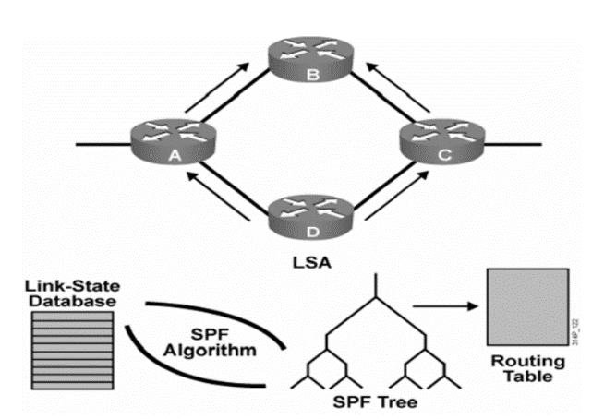
2.2Link-State Routing
The characteristics of LSR protocol
SPF (Shortest Path First Algorithm) [Dijkstra’s Algorithm]
Precise Metrics(Bandwidth, Delay and other QoS parameter)
Identical Database
Provides Hierarchical Structure
Triggered Update
Efficient and Fast Convergence Without Any Loop
Pros and Cons of LSR
Respond Quickly
Small Packet Size
Complex Algorithm
High Memory Consumption & Processor Requirements
Difficult to Configure
Poor Performance on Constantly Changing Links
Figure Source: Khan, Murad; Javaid, Nadeem. (2019, February).
“Routing in IP-based Networks.” Thesis. pp.14.[51].

Slide 8
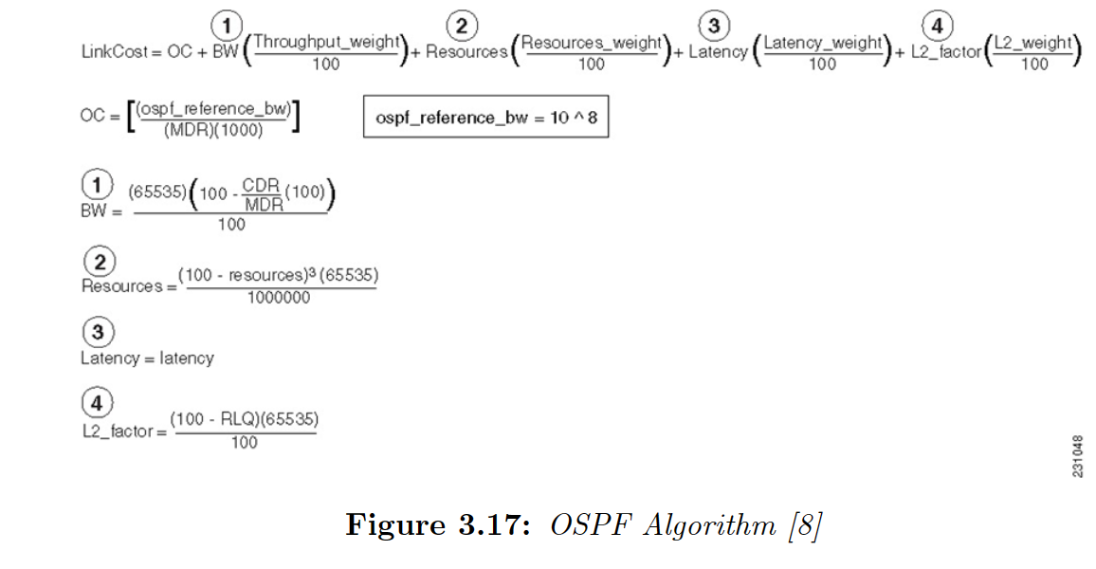
2.2.1Open Shortest Path First
OSPF:
Suitable for large networks or environments that require rapid convergence
Specifically designed for IP networks, so IP routing is calculated directly
Calculating costs mainly relies on bandwidth
Figure Source: Khan, Murad; Javaid, Nadeem. (2019, February).
“Routing in IP-based Networks.” Thesis. pp.33.[51].

Slide 9
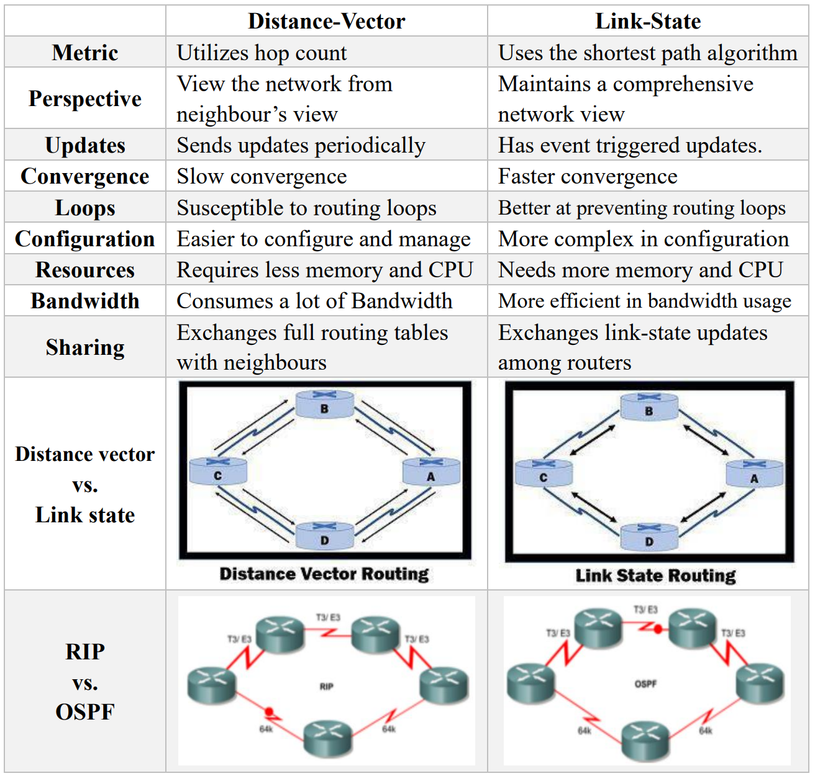
2.3Comparative Analysis

Slide 10
3.Implementation
Use Cisco to build the following simulation scenario:
3.1 Small-Scale Network (Suitable for RIP)
3.2 Large Enterprise Network (Suitable for OSPF)
3.3 Hybrid Network (Coexistence of RIP and OSPF)
Notes:
To gain a comprehensive understanding of dynamic routing protocols, particularly the distinctions between RIP and OSPF.

Slide 11
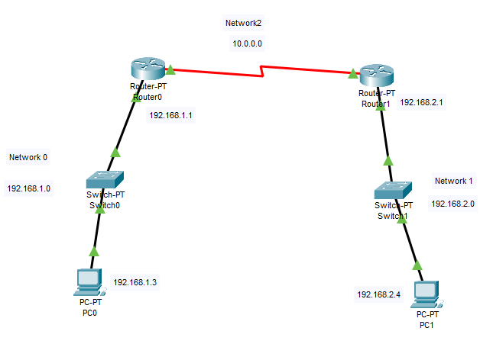
3.1Small-Scale Network (RIP)
Build a Small-Scale Network

Slide 12
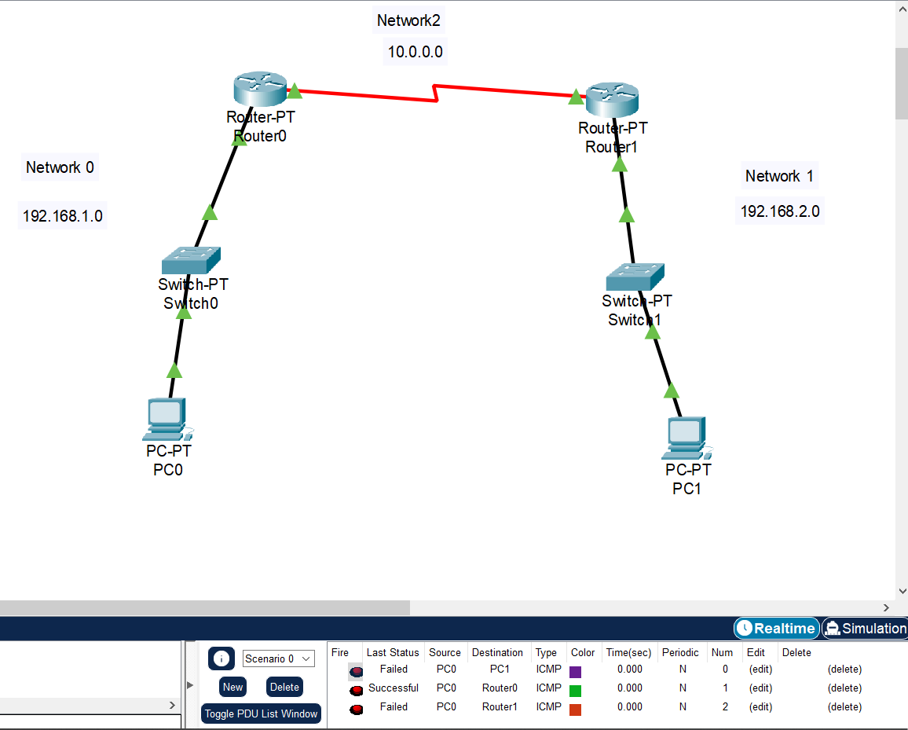
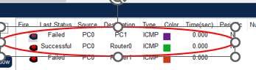
3.1Small-Scale Network (RIP)
Ping PC1 from PC0 failed,
Ping Router0 from PC0 succeeded.
Because RIP is not configured yet
→ nework0 and network1 cannot communicate.

Slide 13
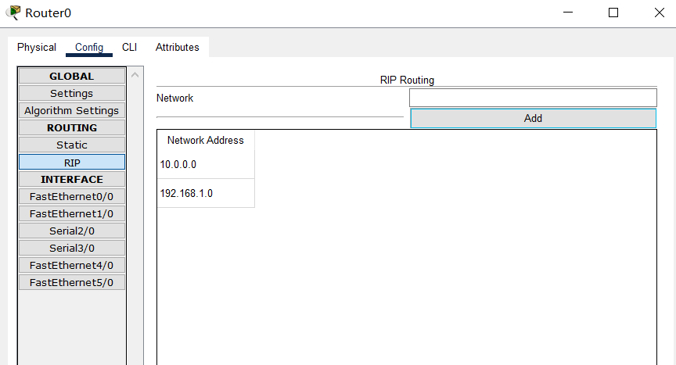
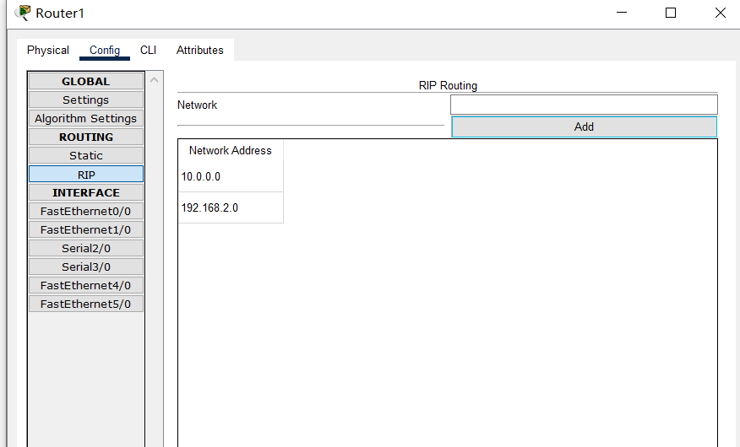
3.1Small-Scale Network (RIP)
Configure RIP on Router1 and Route0 save it.

Slide 14
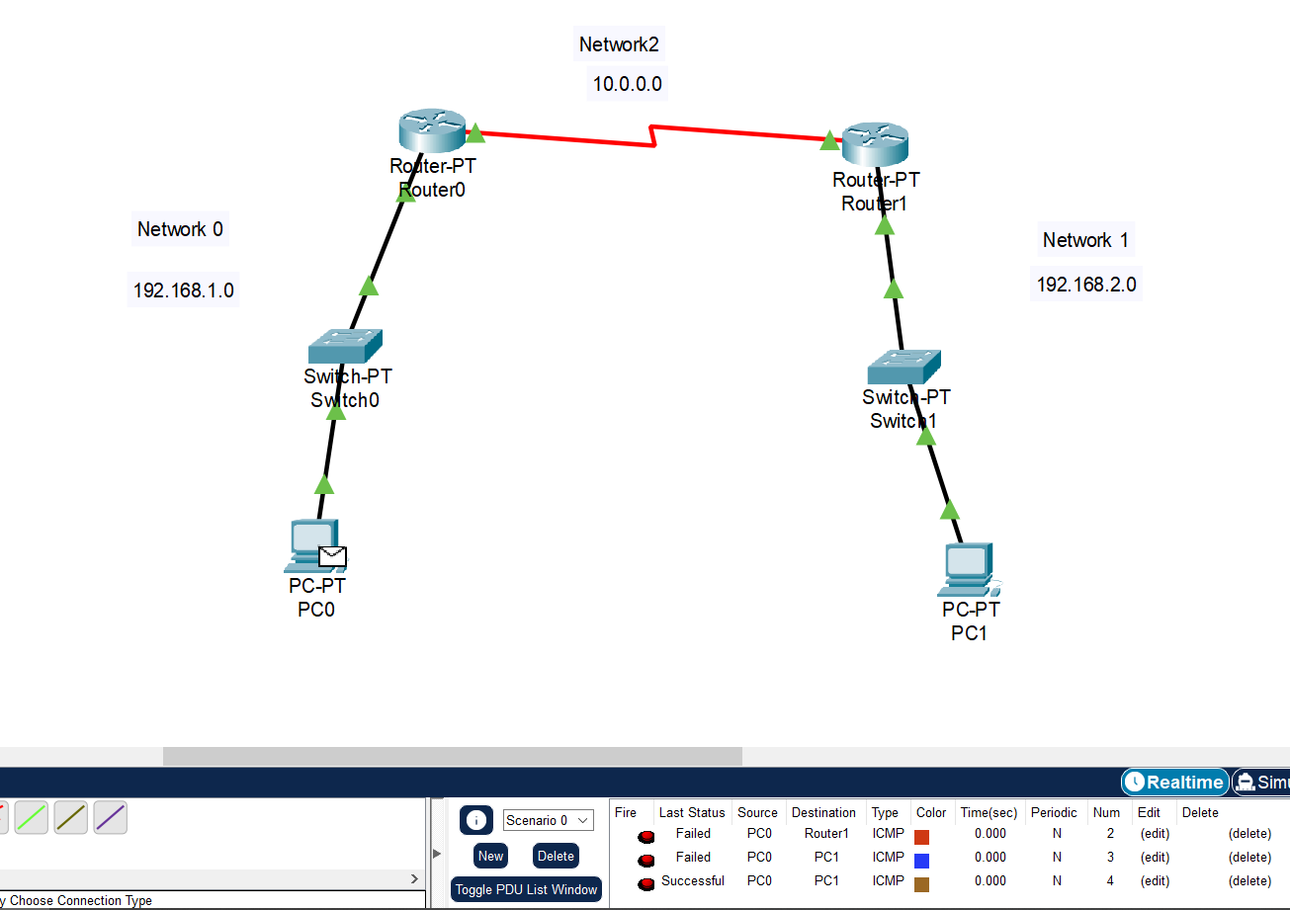
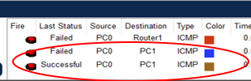
3.1Small-Scale Network (RIP)
Ping PC1 from PC0 failed the first time
Ping succeeded the second time.
Because it takes time for the RIP protocol to update the routing table.

Slide 15
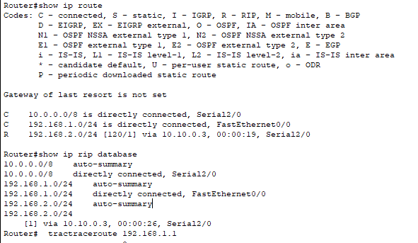
3.1Small-Scale Network (RIP)
Check Routing Table of R1

Slide 16
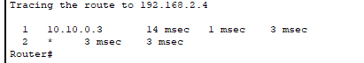
3.1Small-Scale Network (RIP)
Check HOP form PC0 to PC1

Slide 17
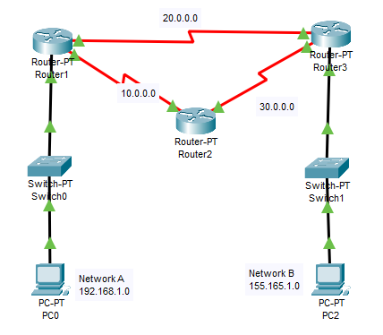
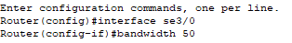
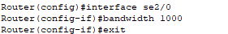
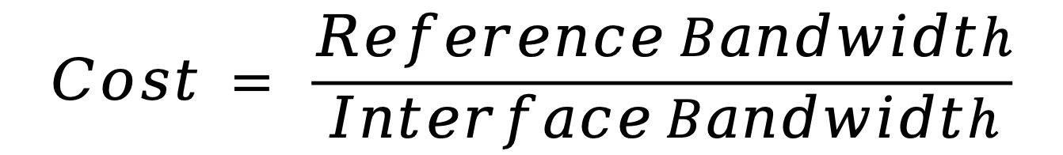
3.2Large Enterprise Network (OSPF)
Build a simplified single-area OSPF network
$$Cost = \frac{Reference Bandwidth}{Interface Bandwidth}$$

Slide 18
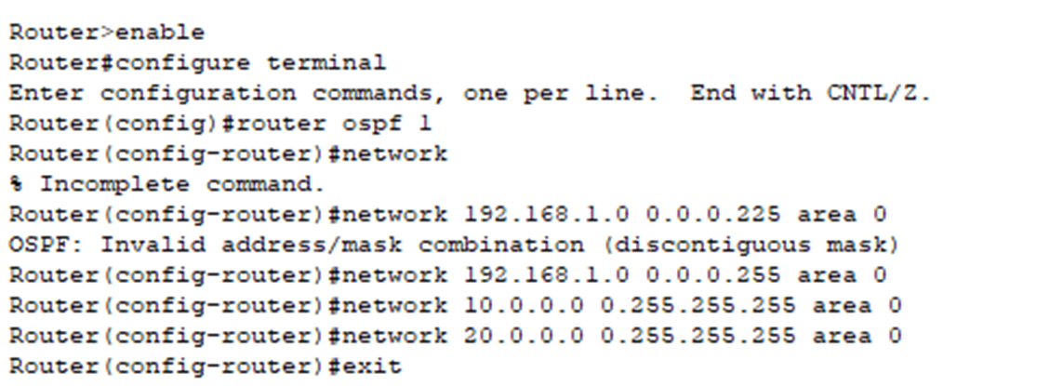
3.2Large Enterprise Network (OSPF)
Configure OSPF protocol on routers

Slide 19
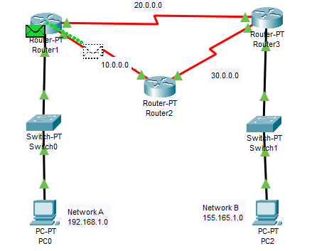
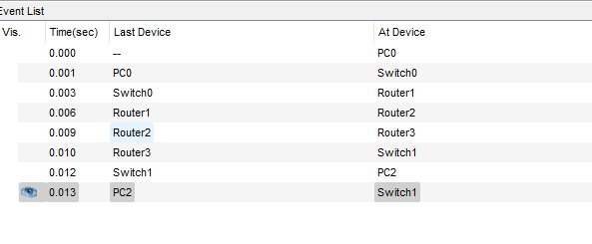
3.2Large Enterprise Network (OSPF)
Stimulate the OSPF network

Slide 20
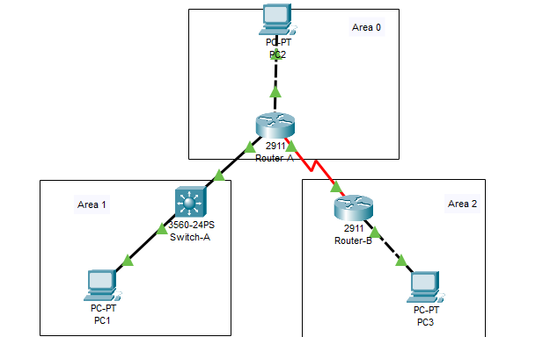
3.2Large Enterprise Network (OSPF)
Build the multi-area OSPF network

Slide 21
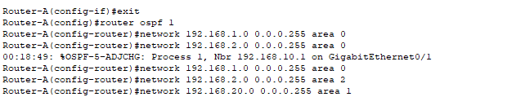
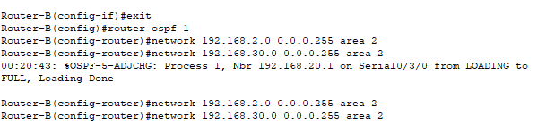
3.2Large Enterprise Network (OSPF)
Configure OSPF protocol on routers

Slide 22
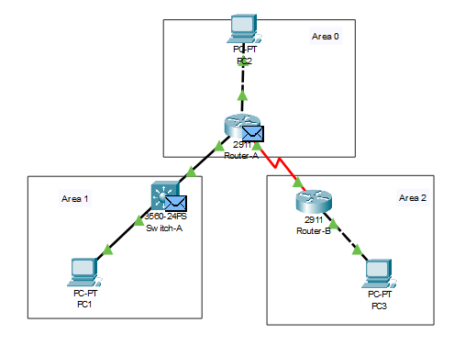
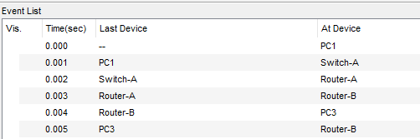
3.2Large Enterprise Network (OSPF)
Stimulate the netork

Slide 23
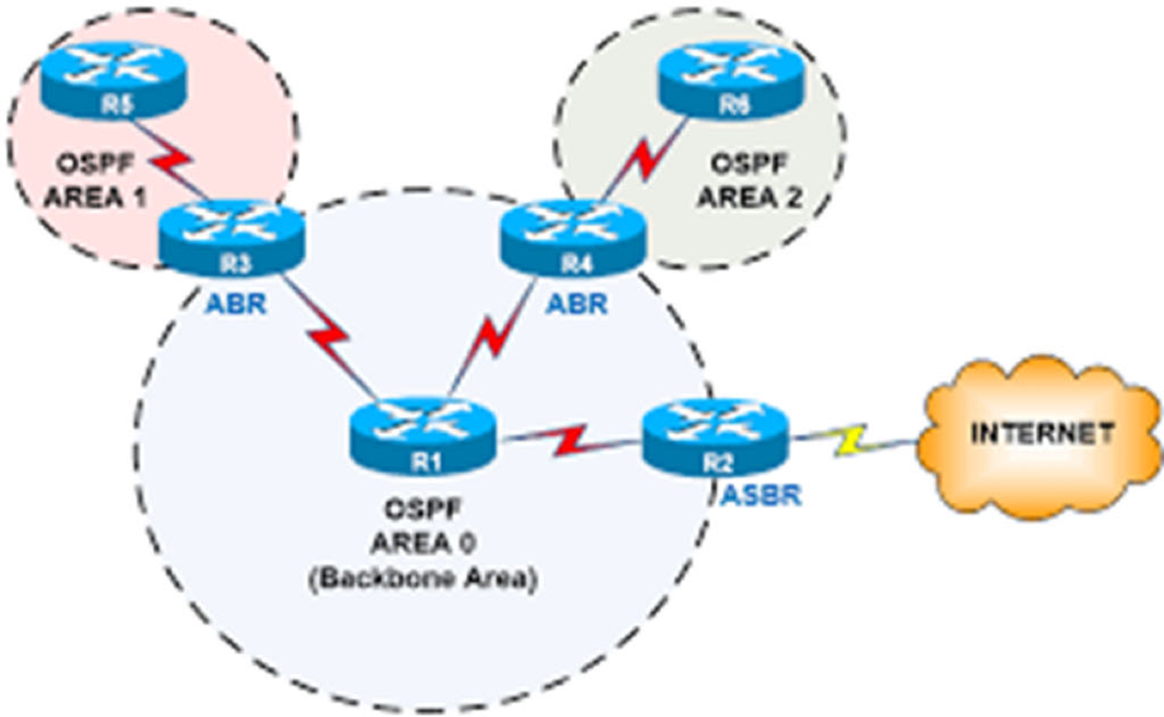
3.2Large Enterprise Network (OSPF)
Advantage
Scalability
Efficient Routing
Disadvantages
Complexity
Resource Intensive

Slide 24
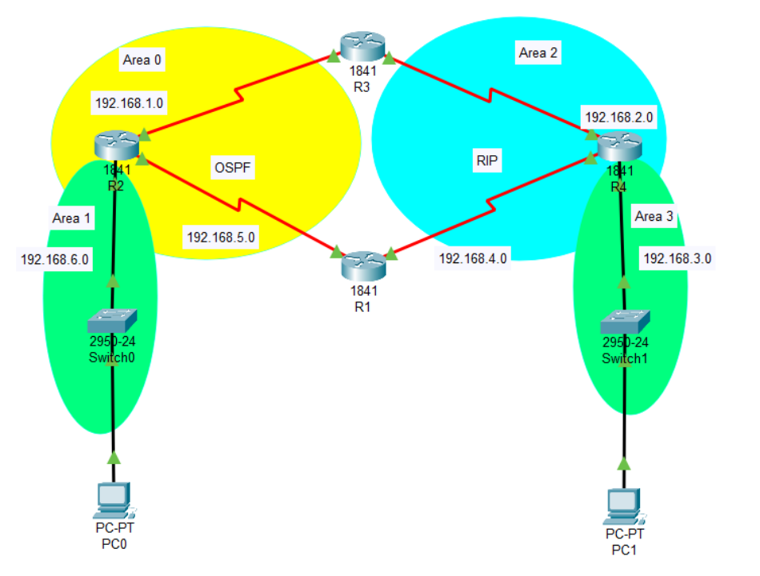
3.3Hybrid Network (RIP and OSPF)
Redistribution
Convert RIP and OSPF metrics to make them compatible

Slide 25
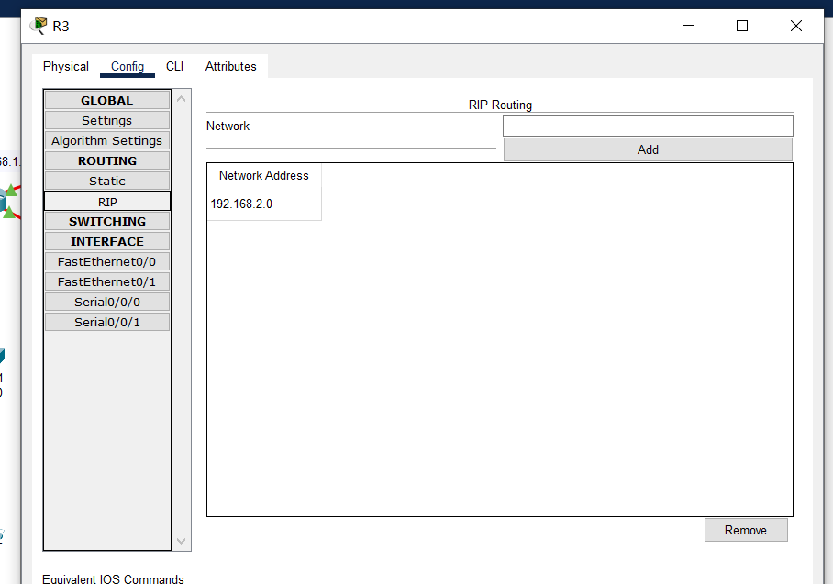
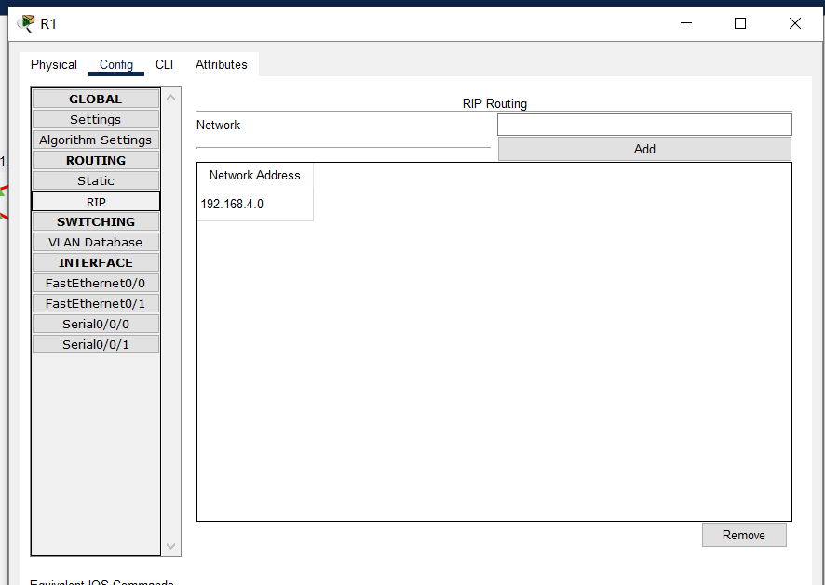
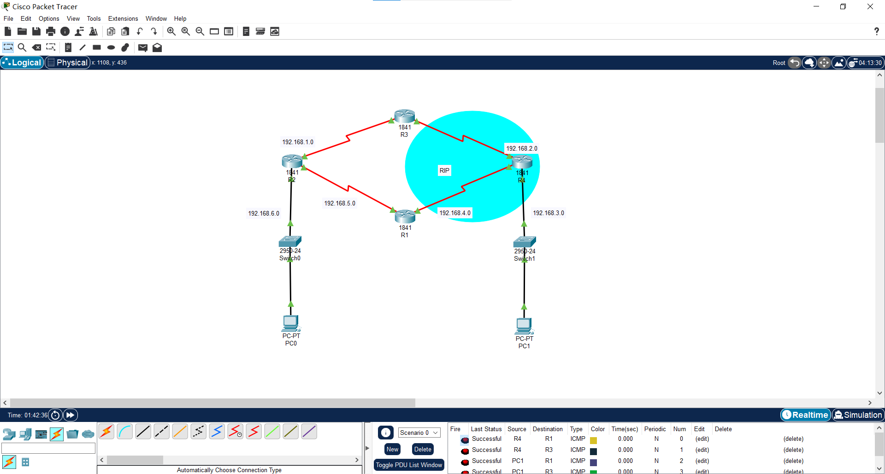
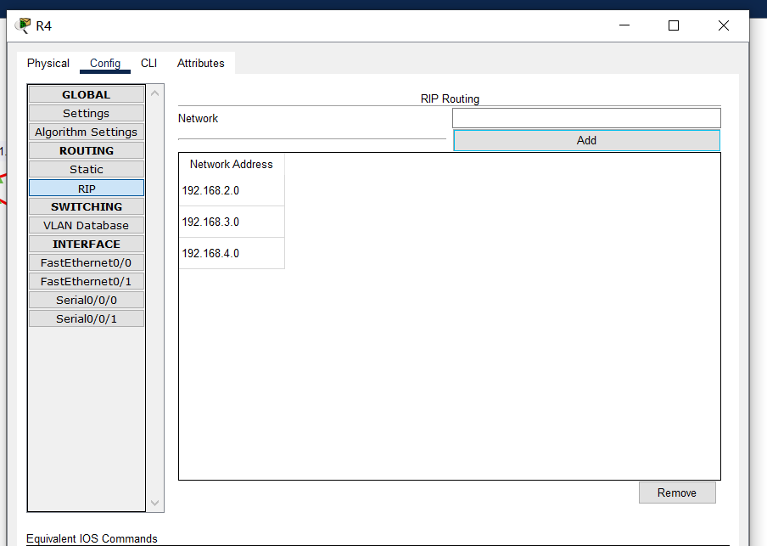
3.3Hybrid Network (RIP and OSPF)
Configure RIP for the router in Area2
Specify the network participating in RIP

Slide 26
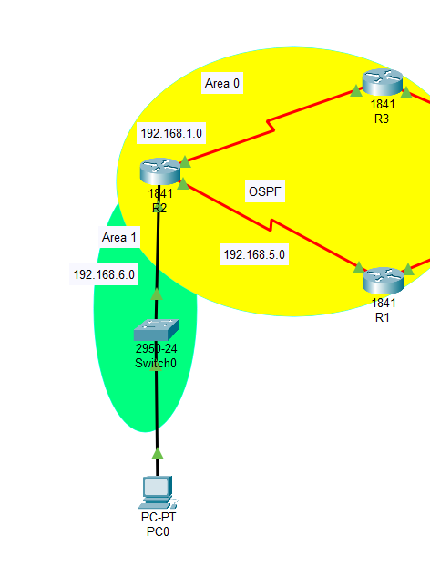
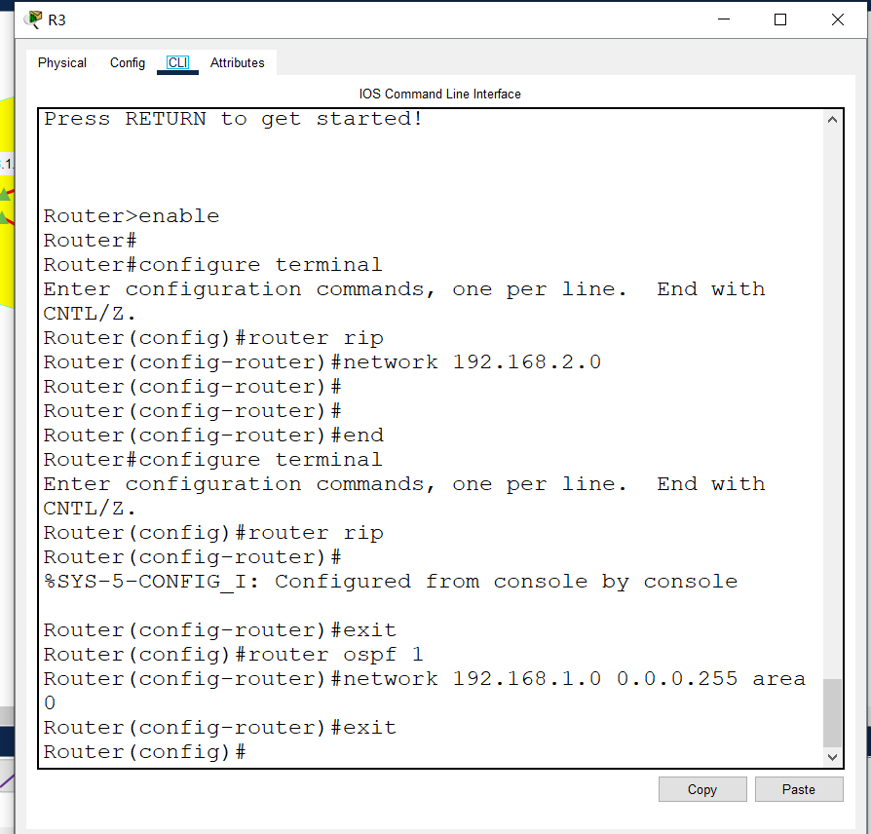
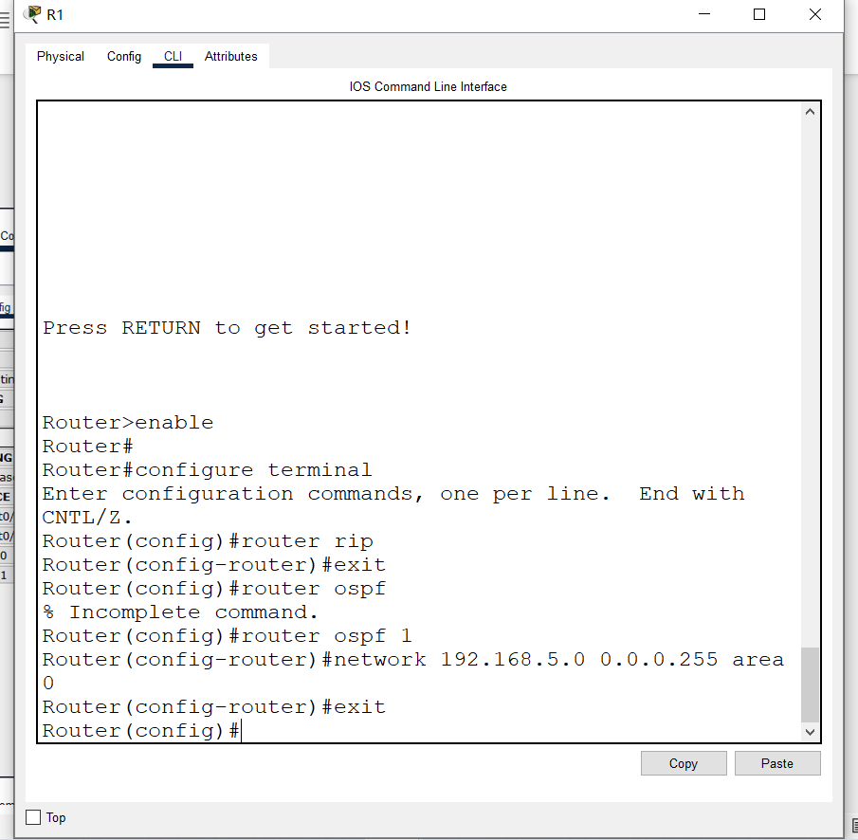
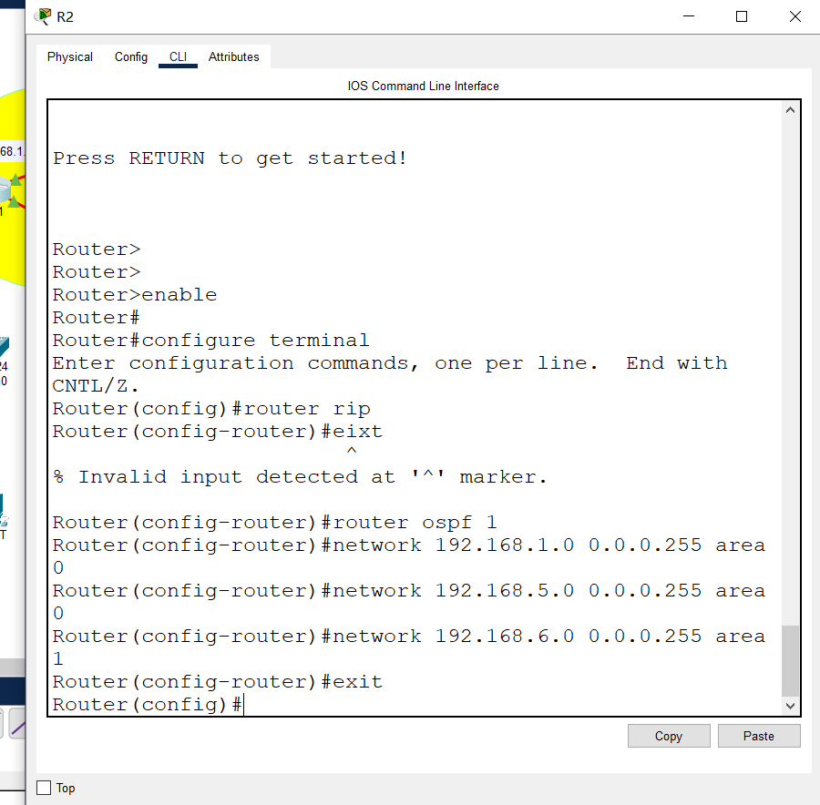
3.3Hybrid Network (RIP and OSPF)
Configure OSPF for the router in Area 0 and Area 1
R3
R1
OSPF area division
The OSPF process numbers of adjacent routers must be the same.

Slide 27
3.3Hybrid Network (RIP and OSPF)
Configure OSPF redistribution into RIP
Border router
Router that performs route redistribution

Slide 28
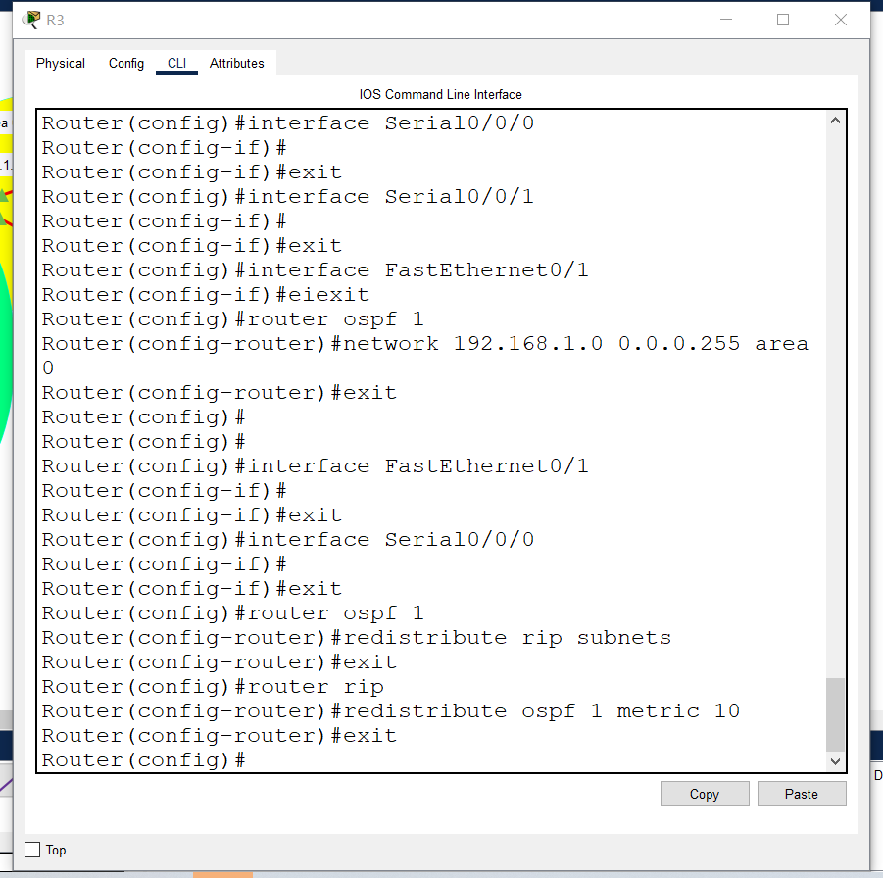
3.3Hybrid Network (RIP and OSPF)
Configure OSPF redistribution into RIP
Redistribute RIP routing information in the OSPF process
OSPF incorporates the subnet information learned by RIP into the OSPF routing table
Redistribute OSPF routing information in the RIP process
The imported OSPF route will be set with a metric value of 10 instead of using the default RIP hop count.

Slide 29
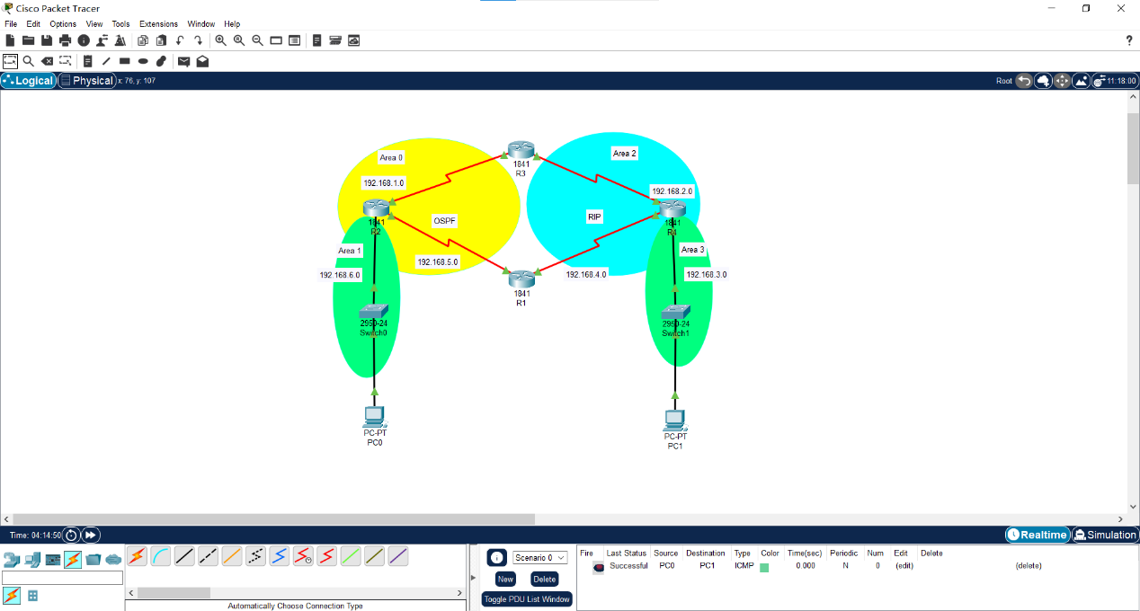
3.3Hybrid Network (RIP and OSPF)
Verify network connectivity

Slide 30
3.3Hybrid Network (RIP and OSPF)
Advantages
Interoperability: Supports legacy systems where RIP is already in place, allowing for a smoother transition to more advanced OSPF without immediate full-scale upgrades.
Flexibility: Enables phased network upgrades, transitioning individual segments to OSPF while maintaining overall network service.
Cost-Effectiveness: May defer costs associated with upgrading hardware that does not support OSPF.
Disadvantages
Complexity: Managing two protocols increases the complexity of the network, necessitating advanced knowledge and careful configuration to prevent issues like routing loops and asynchronous routing tables.
Inconsistency in Metrics: OSPF and RIP use different metrics for determining the best path, which can lead to suboptimal routing decisions when the protocols interact.
Administrative Overhead: Requires careful tuning of redistribution between the protocols to maintain a consistent and loop-free environment.

Slide 31
4.Conclusion
How Choosing Between RIP and OSPF:
Depends on network size, complexity, and requirements for efficiency and scalability.
Each protocol has its specific use case and operational objectives.
 | RIP | OSPF
Scale | Small | Large
Complexity | Low | High
Overhead | High in bandwidth Low in computation | Low in bandwidth High in computation
User friendly | High | Low
Notes:
怎么选择？

